Slide 1

Artificial Intelligence Lecture 20: Confusion Matrix in Machine Learning
Farhad Muhammad Riaz

Slide 2
Contents Binary classifier confusion matrix accuracy precision recall ROC curve - how to plot roc curve

Slide 3
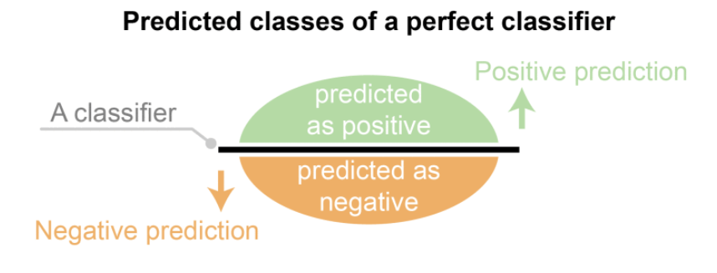
Binary Classifier
A binary classifier produces output with two class values or labels, such as Yes/No, 1/0, Positive/Negative for given input data
A dataset used for performance evaluation is called a test dataset
Observed labels are used to compare with the predicted labels for performance evaluation after classification
The predicted labels will be exactly the same if the performance of a classifier is perfect
But it is uncommon to be able to develop a perfect classifier

Slide 4
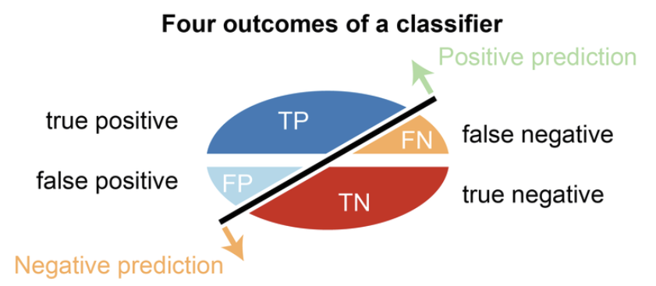
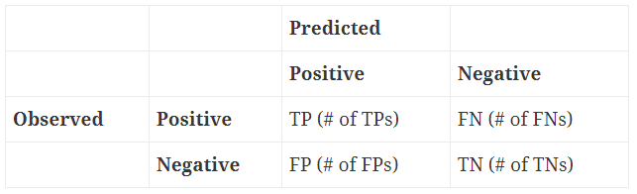
Confusion Matrix
A confusion matrix is formed from the four outcomes produced as a result of binary classification
True positive (TP): correct positive prediction
False positive (FP): incorrect positive prediction
True negative (TN): correct negative prediction
False negative (FN): incorrect negative prediction

Slide 5
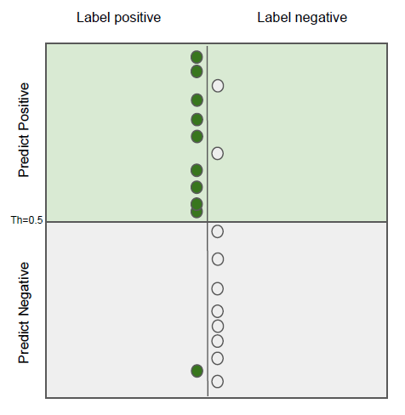
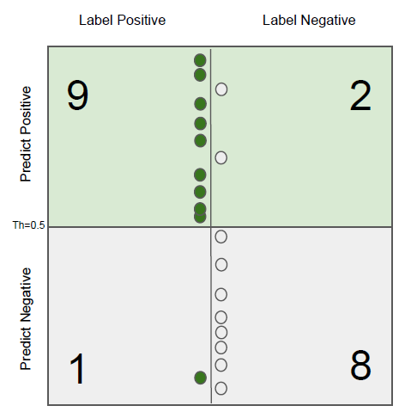
Confusion Matrix
Classifier
Levels : Green / Grey
Confusion Matrix

Slide 6
Confusion Matrix
True Positives
Green examples correctly identified as green
False Positives
Gray examples falsely identified as green
Confusion Matrix
False Negatives
Green examples falsely identified as gray
True Negatives
Gray examples correctly identified as grey

Slide 7
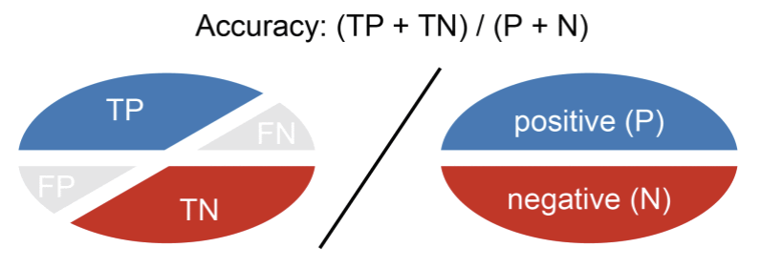
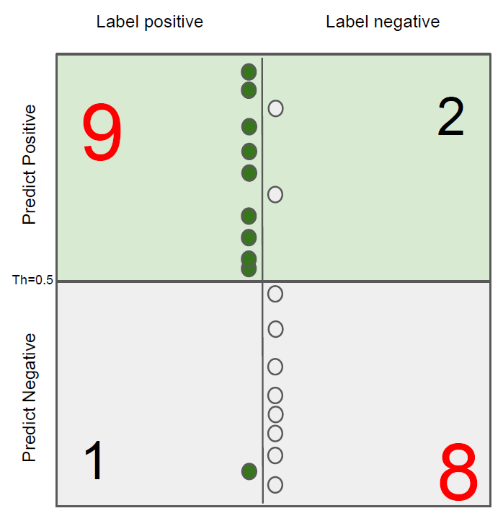
Accuracy
Accuracy is calculated as the number of all correct predictions divided by the total number of the dataset
The best ACC is 1.0, whereas the worst is 0.0
Accuracy = (9+8) / (9+2+1+8) = 0.85

Slide 8
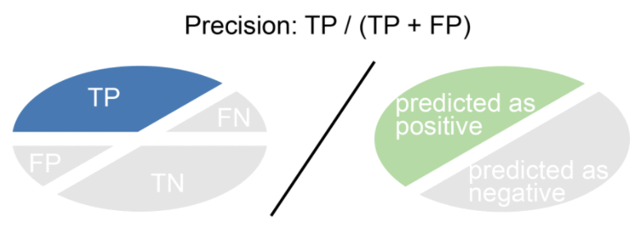
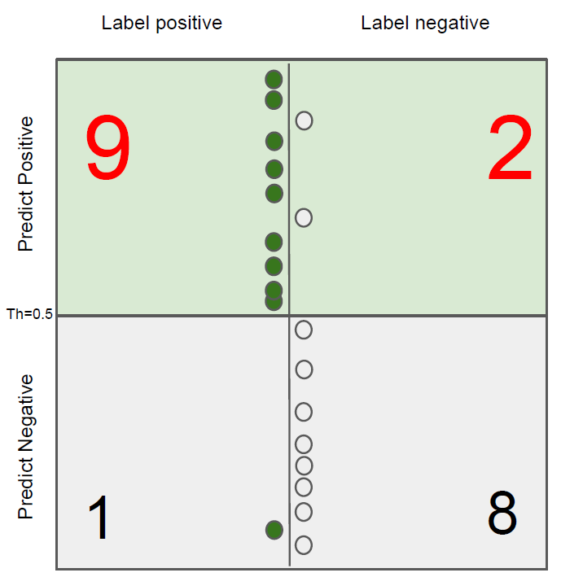
Precision
Precision is calculated as the number of correct positive predictions divided by the total number of positive predictions
The best precision is 1.0, whereas the worst is 0.0
Precision = 9 / (9+2) = 0.81

Slide 9
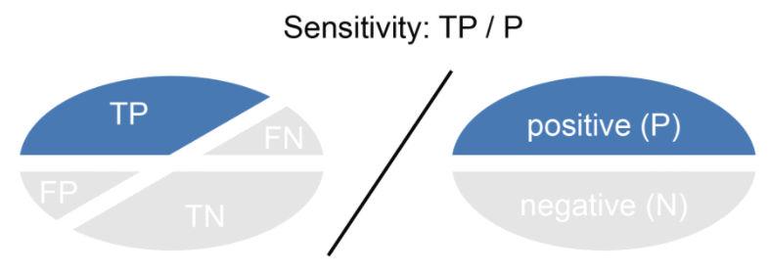
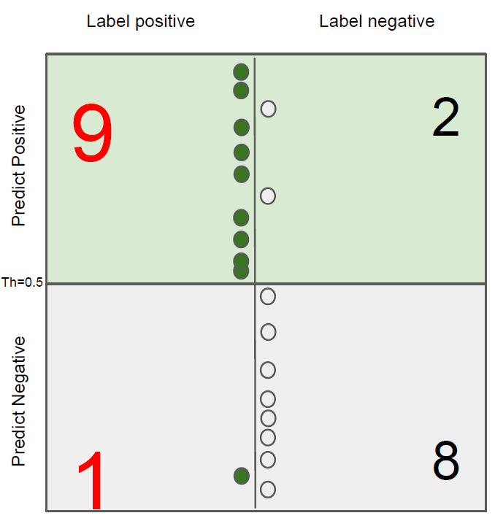
Recall
Sensitivity = Recall = True Positive Rate
Recall is calculated as the number of correct positive predictions divided by the total number of positives
The best recall is 1.0, whereas the worst is 0.0
Recall = 9 / (9+1) = 0.9

Slide 10
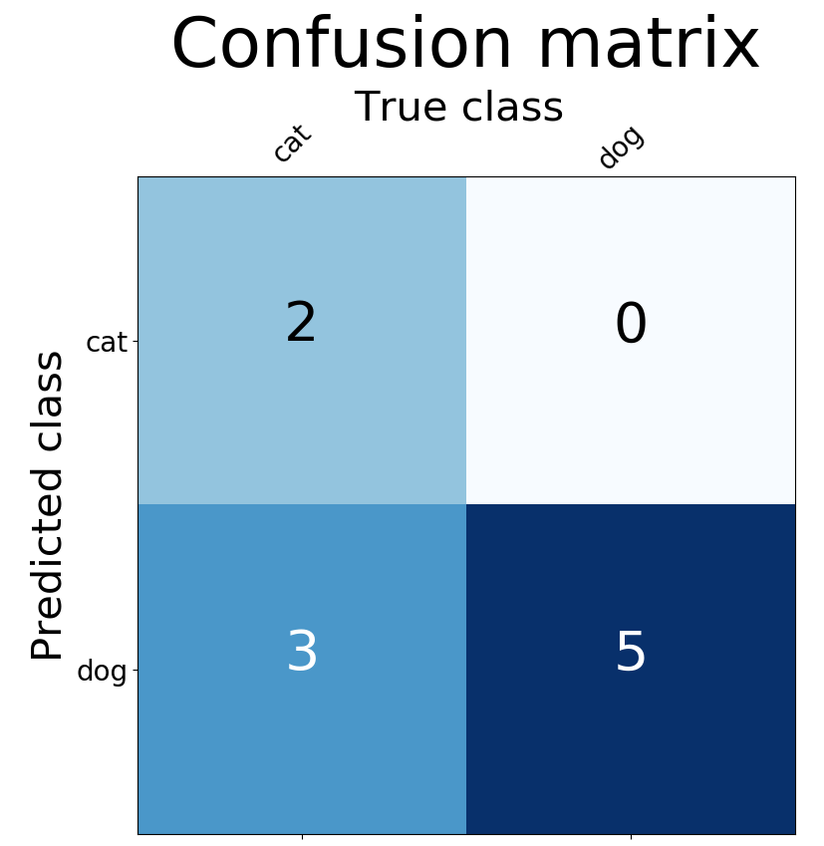
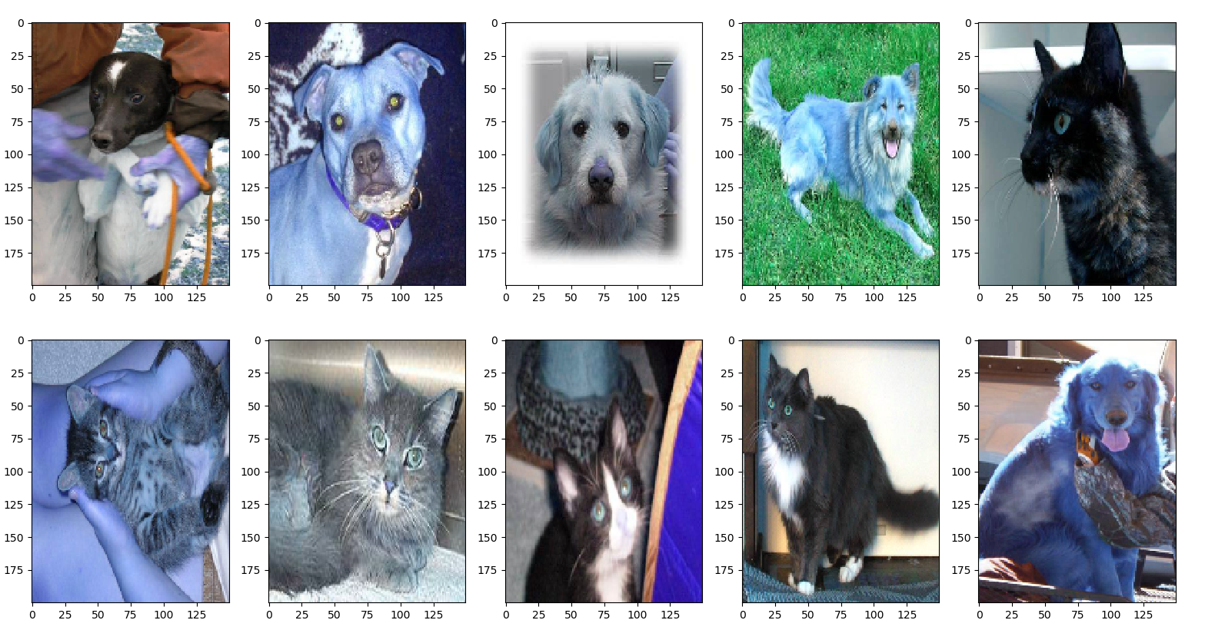
Example 1
Example: The example to classify whether images contain either a dog or a cat
The training data contains 25000 images of dogs and cats;
The training data 75% of 25000 images; (25000*0.75 = 18750)
Validation data 25% of training data; (25000*0.25 = 6250)
Test Data, 5 cats, 5 dogs
Precision = 2/(2 + 0) * 100% = 100%
Recall = 2/(2 + 3) * 100% = 40%
Accuracy = (2 + 5)/(2 + 0 + 3 + 5) * 100% = 70%

Slide 11
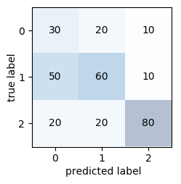
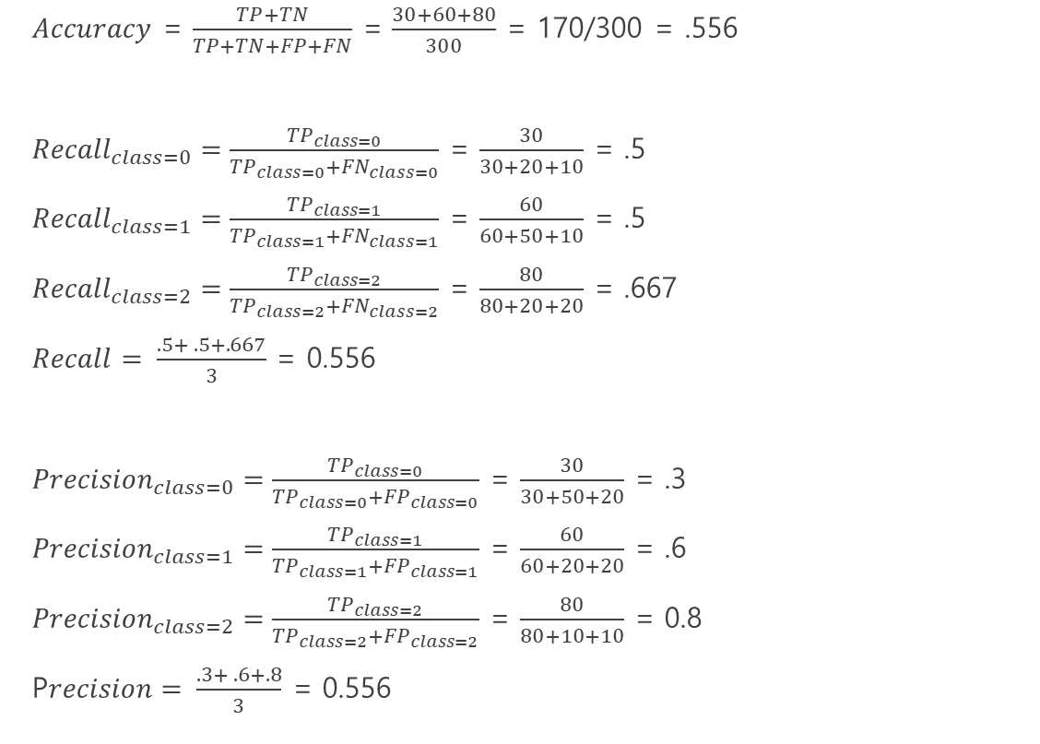
Example 2
$Accuracy$ = $\frac{TP+TN}{TP+TN+FP+FN}$ = $\frac{30+60+80}{300}$ = 170/300 = .556
${Recall}_{class=0}=\frac{{TP}_{class=0}}{{TP}_{class=0}+{FN}_{class=0}}$ = $\frac{30}{30+20+10}$ = .5
${Recall}_{class=1}=\frac{{TP}_{class=1}}{{TP}_{class=1}+{FN}_{class=1}}$ = $\frac{60}{60+50+10}$ = .5
${Recall}_{class=2}=\frac{{TP}_{class=2}}{{TP}_{class=2}+{FN}_{class=2}}$ = $\frac{80}{80+20+20}$ = .667
$Recall= \frac{.5+ .5+.667}{3}$ = 0.556
${Precision}_{class=0}=\frac{{TP}_{class=0}}{{TP}_{class=0}+{FP}_{class=0}}$ = $\frac{30}{30+50+20}$ = .3
${Precision}_{class=1}=\frac{{TP}_{class=1}}{{TP}_{class=1}+{FP}_{class=1}}$ = $\frac{60}{60+20+20}$ = .6
${Precision}_{class=2}=\frac{{TP}_{class=2}}{{TP}_{class=2}+{FP}_{class=2}}$ = $\frac{80}{80+10+10}$ = 0.8
P$recision= \frac{.3+ .6+.8}{3}$ = 0.556

Slide 12
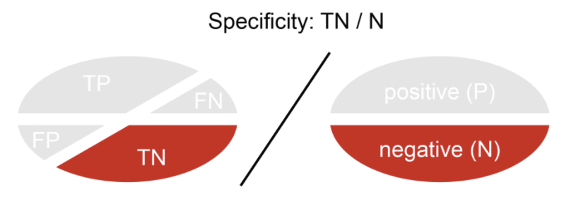
ROC Curve
The Receiver Operating Characteristics(ROC) curve
The ROC curve is a evaluation measure that is based on two basic evaluation measures - specificity and sensitivity
Specificity = True Negative Rate
Sensitivity = Recall = True Positive Rate
Specificity
Specificity is calculated as the number of correct negative predictions divided by the total number of negatives

Slide 13
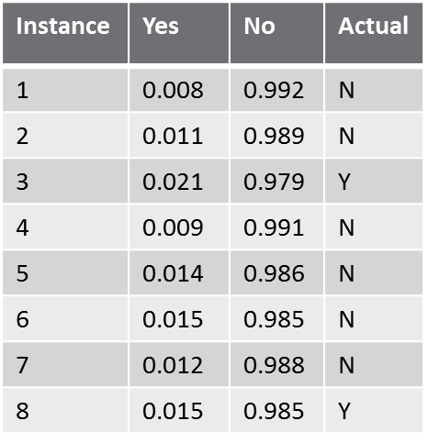
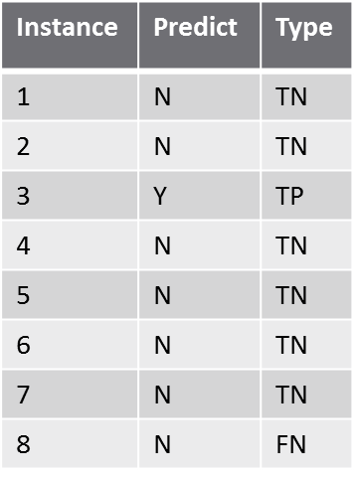
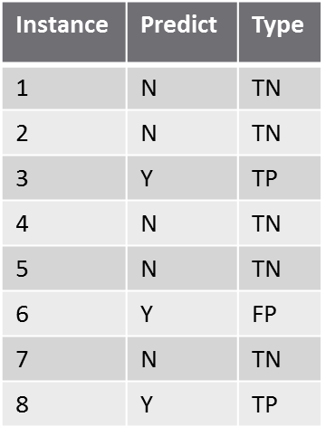
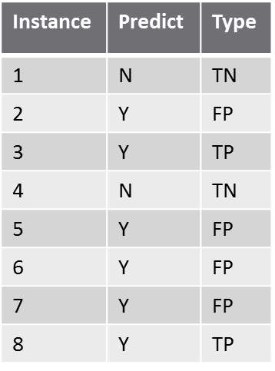
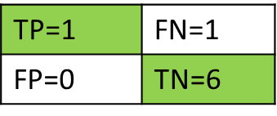
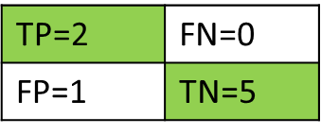

How to Plot ROC Curve
Dynamic cut-off thresholds
Cut-off = 0.020
Cut-off = 0.015
Cut-off = 0.010

Slide 14
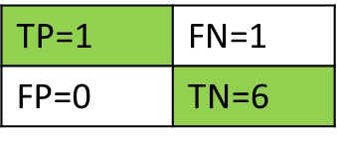


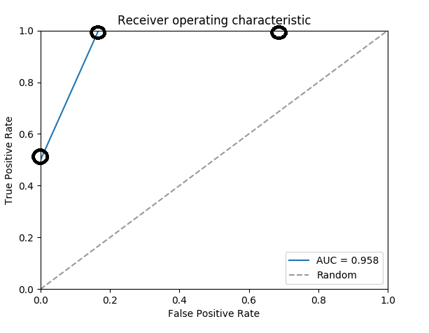
How to Plot ROC Curve
True positive rate (TPR) = 𝑇𝑃/(𝑇𝑃+𝐹𝑁) and False positive rate (FPR) = 𝐹𝑃/(𝐹𝑃+𝑇𝑁)
Use different cut-off thresholds (0.00, 0.01, 0.02,…, 1.00), calculate the TPR and FPR, and plot them into graph. That is receiver operating characteristic (ROC) curve.
Example
TPR = 0.5
FPR = 0
TPR = 1
FPR = 0.167
TPR = 1
FPR = 0.667

Slide 15
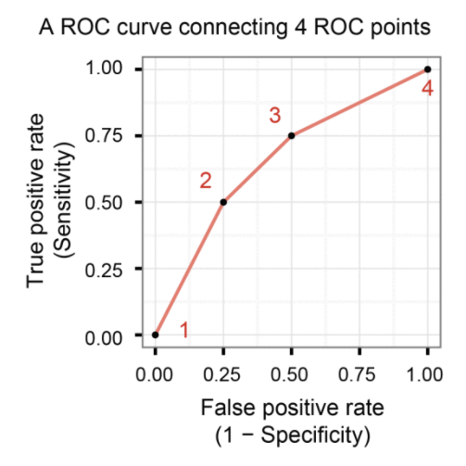
How to Plot ROC Curve
A ROC curve is created by connecting ROC points of a classifier
A ROC point is a point with a pair of x and y values where x is 1-specificity and y is sensitivity
The curve starts at (0.0, 0.0) and ends at (1.0, 1.0)

Slide 16
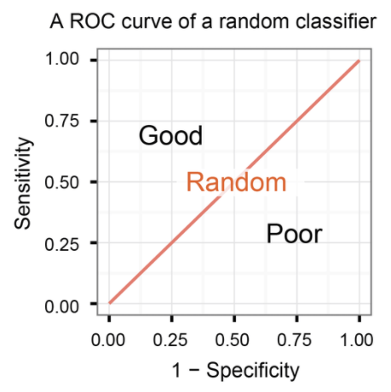
ROC Curve
A classifier with the random performance level always shows a straight line
Two areas separated by this ROC curve
ROC curves in the area with the top left corner indicate good performance levels
ROC curves in the other area with the bottom right corner indicate poor performance levels

Slide 17
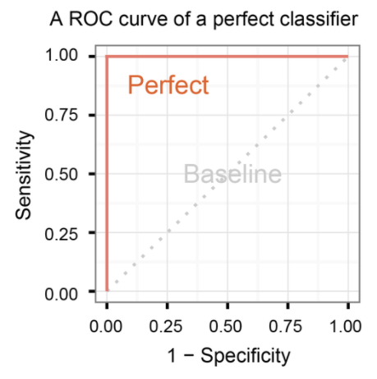
ROC Curve
A classifier with the perfect performance level shows a combination of two straight lines
It is important to notice that classifiers with meaningful performance levels usually lie in the area between the random ROC curve and the perfect ROC curve

Slide 18
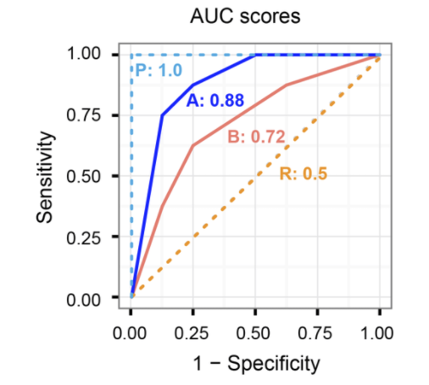
ROC Curve
AUC(Area under the ROC curve) score
An advantage of using ROC curve is a single measure called AUC score
As the name indicates, it is an area under the curve calculated in the ROC space
Although the theoretical range of AUC score is between 0 and 1, the actual scores of meaningful classifiers are greater than 0.5, which is the AUC score of a random classifier
ROC curves clearly shows classifiers A outperforms classifier B

Slide 19
References
https://classeval.wordpress.com/introduction/basic-evaluation-measures/
https://classeval.wordpress.com/introduction/introduction-to-the-roc-receiver-operating-characteristics-plot/
Evaluation Metrics (Classifiers) / CS229 Section / Anand Avati

Slide 20

Thank you.

